Slide 1
Swans
By Annabeth Boyd

Slide 2
There are 6-7 species of swan including the mute swan, trumpeter swan, and whooper swan, American whistling swan, South American black- necked swan, Australian black swan, and European white swan.

Slide 3
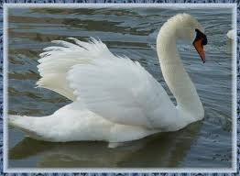
Males are called a cob. Females are called a pen. The names given to babies are signets.

Slide 4
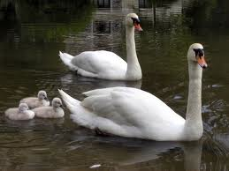
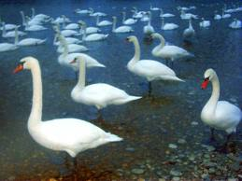
There are four groups of Animals there are fish, birds, mammals, and amphibians. Swans are birds

Slide 5
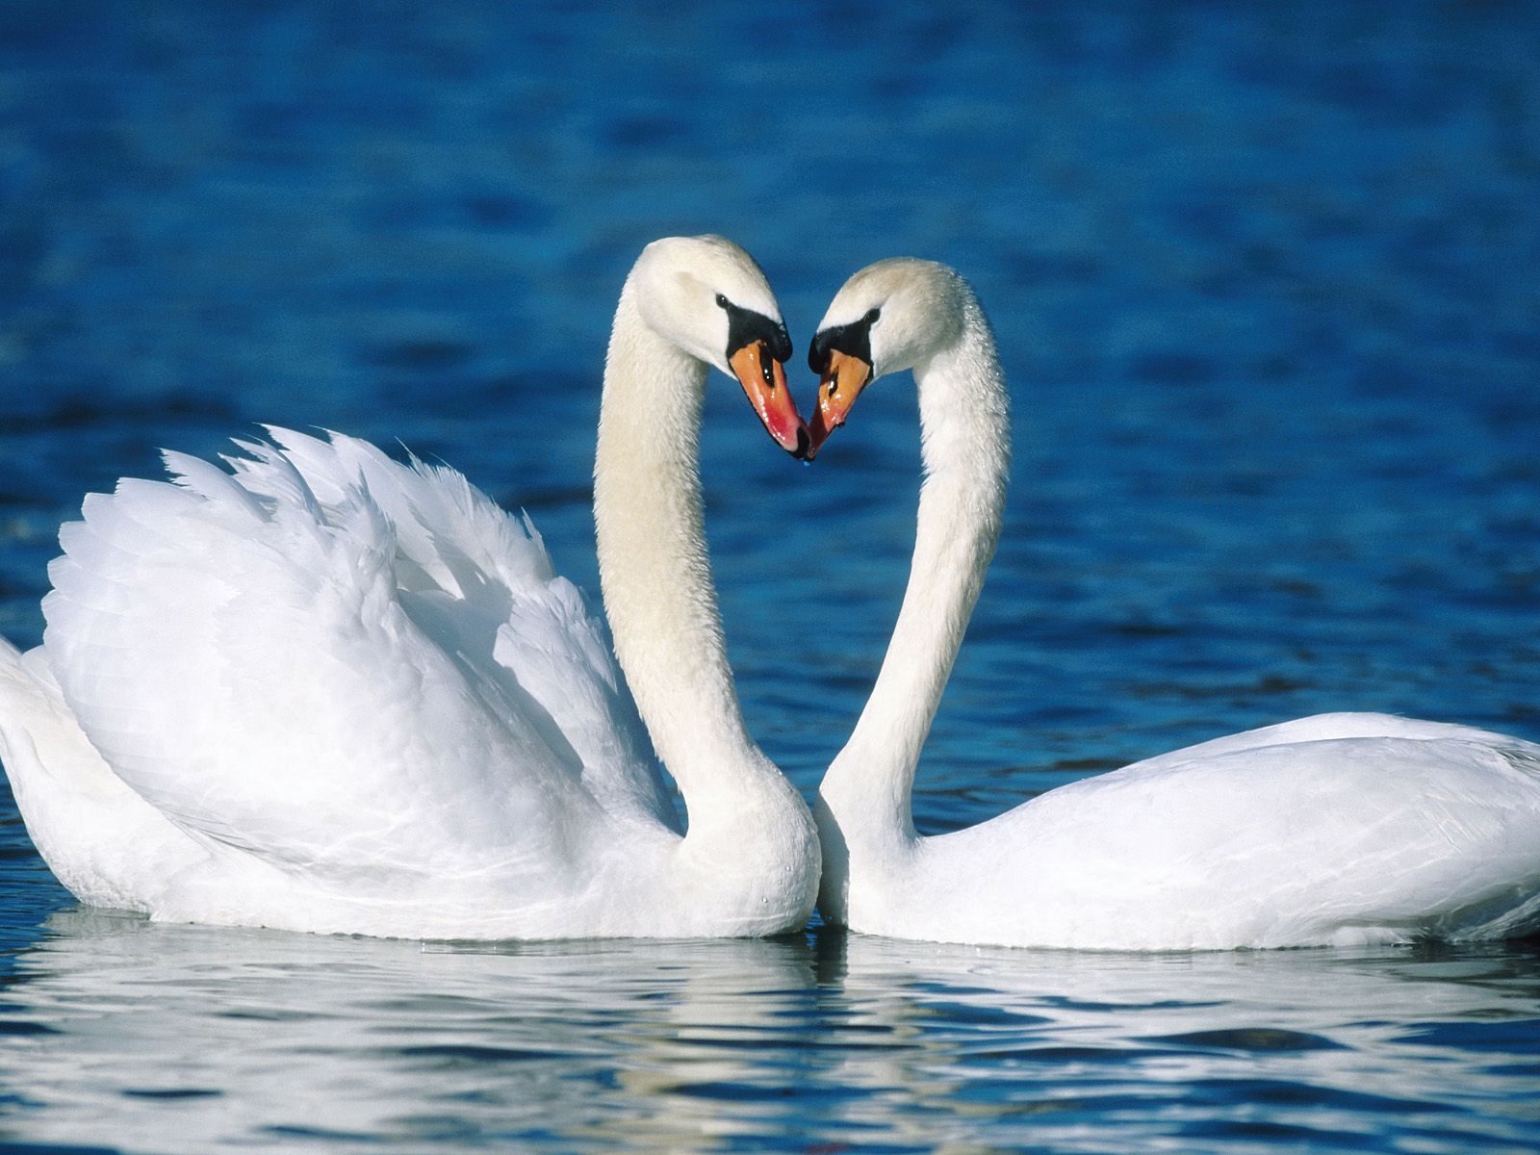
Swans live in fresh water ponds and lakes. They eat fish. When they are in the water they put their beak down into the water and catch the fish.

Slide 6
Swans are vertebras. Vertebras are animals that have a back bone.

Slide 7
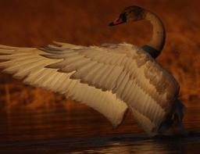
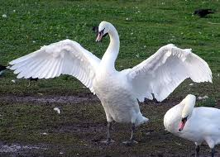
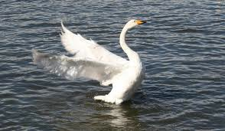
A swan has no predators. A swan is harmless but if you bother it than it will bother you. Swans use their feathers to scare off things bigger than them.

Slide 8
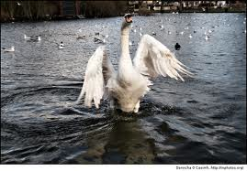
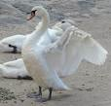
Swans are the largest waterfowls. Swans can weigh over 30 pounds.

Slide 9
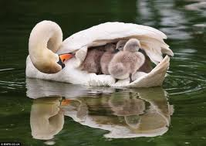
Swans mate for life. They only take care of their young for a year.

Slide 10
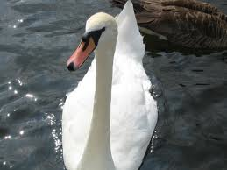
I hope this helped you learn lots of fun facts about swans.

Slide 11
And that is my presentation. ☺ THE END ☺

