Slide 1
Leopards
By: Hannah Crowder
A Report on:

Slide 2
Classification
Class: Mammal
Order: Carnivore
Family: Felidae
Kingdom: Animals
Phylum: Chordata
Subphylum: Vertebrates
Genus: Panthera
Latin name: Panthera Pardus

Slide 3
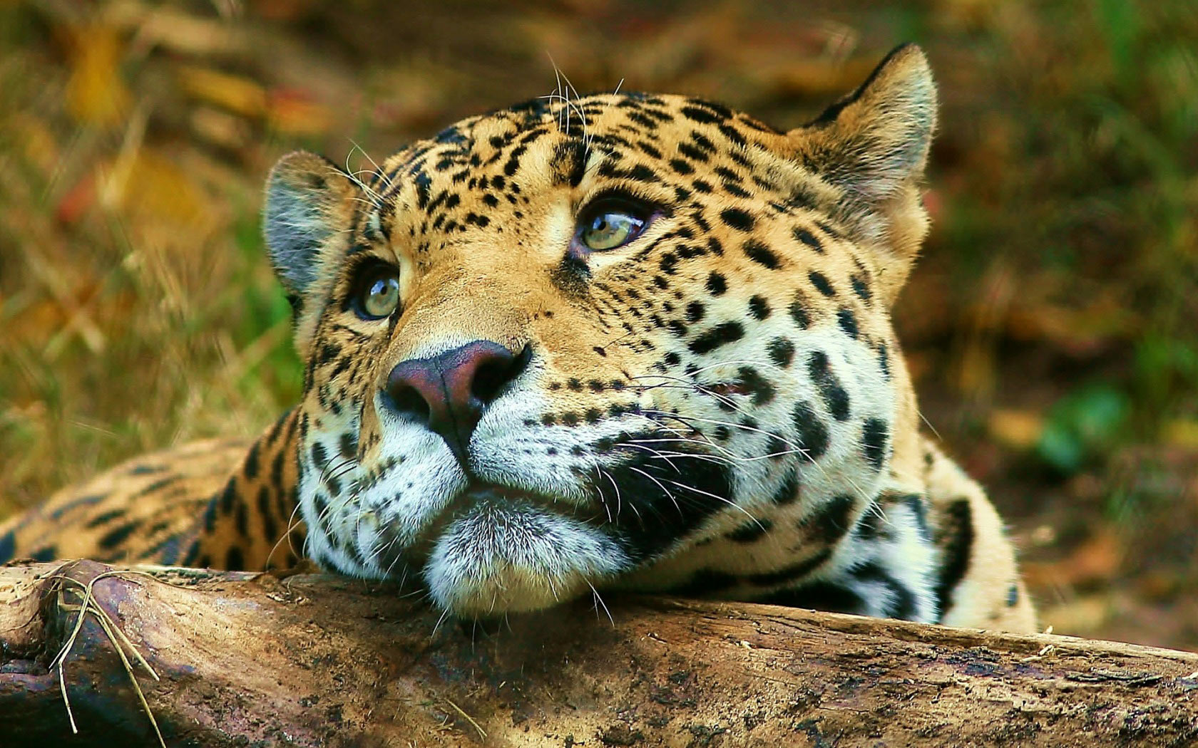
Classification

Slide 4
Homes & Shelter
Habitat: Leopards live in several different places. You can find them anywhere from subtropical forests to deserts. They would rather live in riverine forests and the grasslands of southern Africa called “veld”. These “velds” are usually in game reserves and mountainous areas.

Slide 5
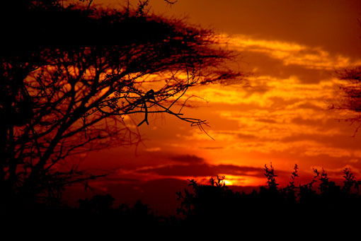
Homes and Shelter

Slide 6
Predator
Since adult leopards are such powerful animals, they rarely have any predators in the wild. Lions, tigers, hyenas, baboons, pythons, and wild dogs may present a challenge to a leopard. There are rare occasions when a leopard might not survive the challenge, but usually the leopard stands victorious.

Slide 7
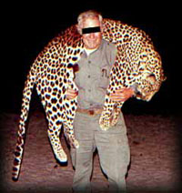
Predator
Man is a leopards predator. Because it is at the top of the food chain

Slide 8
Prey
A leopard eats Dung beetles , Kudu calves, Baboons and foxes.
Leopards either hunt from tree branches and drop down on their pray or from the ground stalking their pray.

Slide 9
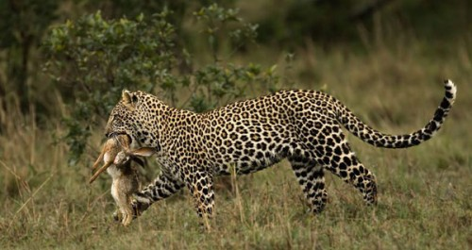
Prey

Slide 10
Adaptations
Usually leopards have a cream colored coat with gold spots that help to camouflage them when they are hunting their prey. Sometimes they have black fur with dark spots. Those leopards are sometimes confused with panthers.
Adult leopards like to be alone. Each adult leopard has its own area where it lives and even though other leopards might be close, they try to avoid one another.
Leopards are made to hunt. Their strong, skinny bodies can run as fast as 57 kilometers per hour. They are also great swimmers and climbers and can jump a long way.
Leopards can easily balance and make sharp turns because of its long tail. (their tails are as long as their bodies)
Leopards can climb down trees headfirst because of their special ankle bones. They can even hang from limbs by only their back feet.
They can travel on rocky surfaces because of the big pads and thick fur on their feet.
Their double layer coat helps them to stay warm in the mountains

Slide 11
Adaptations

Slide 12
The End!
I hope you enjoyed it!!!

