Slide 1
The Poisonous Dart Frog
BY
Grant Mefford

Slide 2
Poisonous Dart Frog
Can be many different colors ; yellow, orange, red, green and blue.
Does not have ears.
Has four legs.
Eats insects
Can live 3-15 years in the wild
Only grows to be ½ - 2 inches

Slide 3
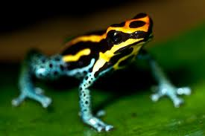
Animal Classification: Amphibian
Cold blooded
Smooth skinned
Hatch as larvae that breath with gills.
Grows to adult that breathes with lungs.

Slide 4
Homes and Shelter
Poisonous dart frogs live in the rainforests of Central and South America. They can also live in captivity such as zoos.

Slide 5
Predators and Prey
With a long sticky tongue that darts out, the frogs slurps unsuspectful insects such as ants, flies, crickets and beetles.
There is only one natural predator not bothered by the frog’s poison, a snake named Leimadophis Epinephelus.

Slide 6
Adaptations
The Poisonous Dart Frog lives in the rain forests of
Central America. They survive on tiny insects.
These tiny insects feed on plants that have toxins.
When eaten by the frog, these toxins are released.
There bright colored skins warn predators to
stay away, I am toxic!

Slide 7
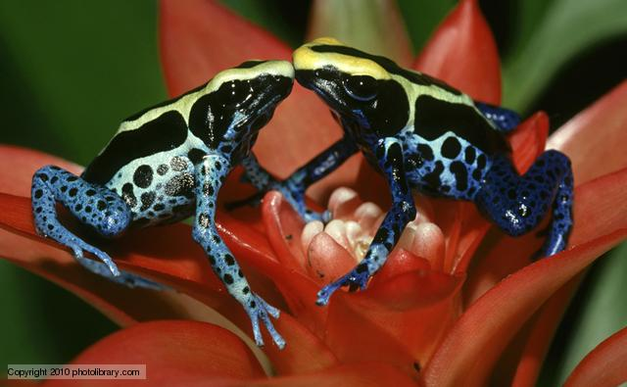
Other Interesting Facts
The Poisonous Dart Frog gets his name from the tribal Indians of Columbia who used to dip the tips of their blow guns darts in the toxic venom. The golden poison dart frog has enough venom to kill 10 grown men.
Poisonous Dart frogs that are kept in captivity such as zoos are actually not venomous. The insects they are fed have not eaten toxic plants.

Slide 8
References
http://animals.nationalgeographic.com/animals/amphibians/poison-frog/
http://www.kidzone.ws/lw/frogs/facts-poison.htm
http://www.sandiegozoo.org/animalbytes/t-poison_frog.html

